Slide 1
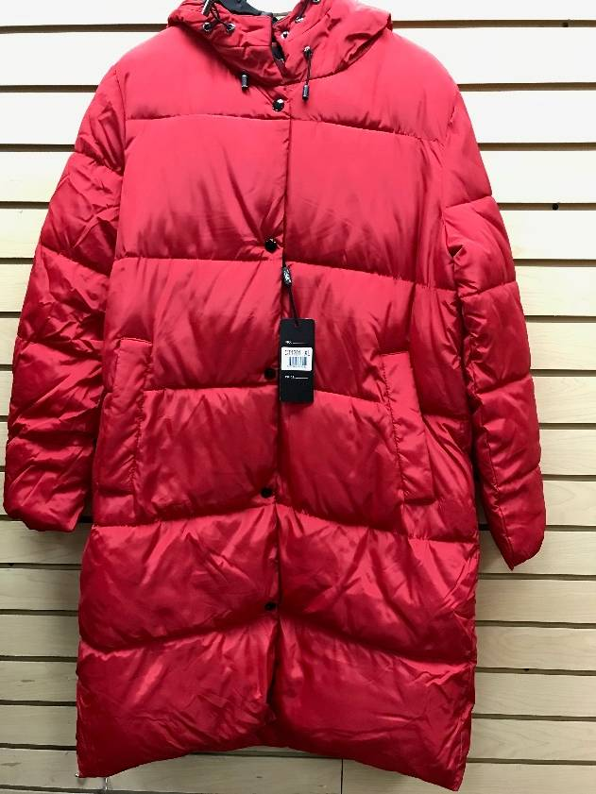
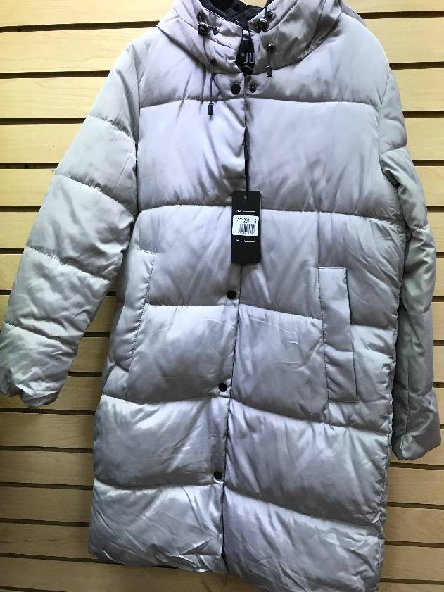
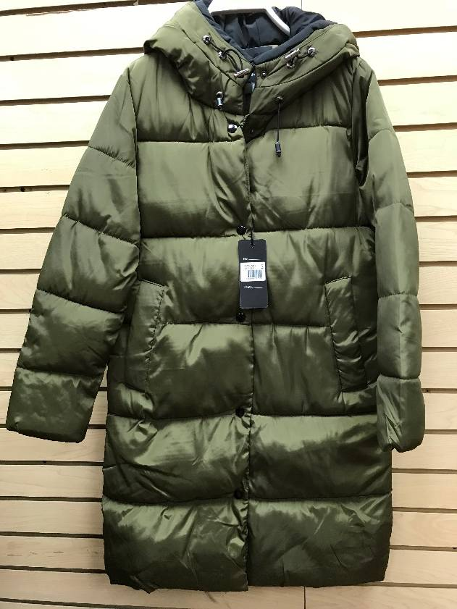
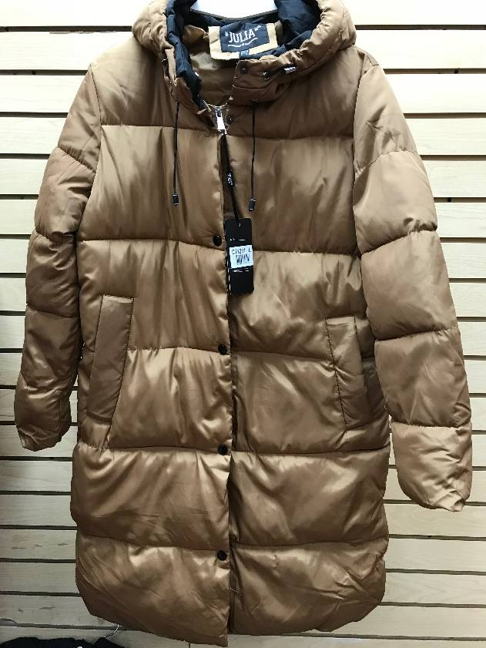
STYLE CT 1201 Blk/324, Red/156, L. Gry/288, Amy/156, Gold/366 = 1,290 PCS

Slide 2
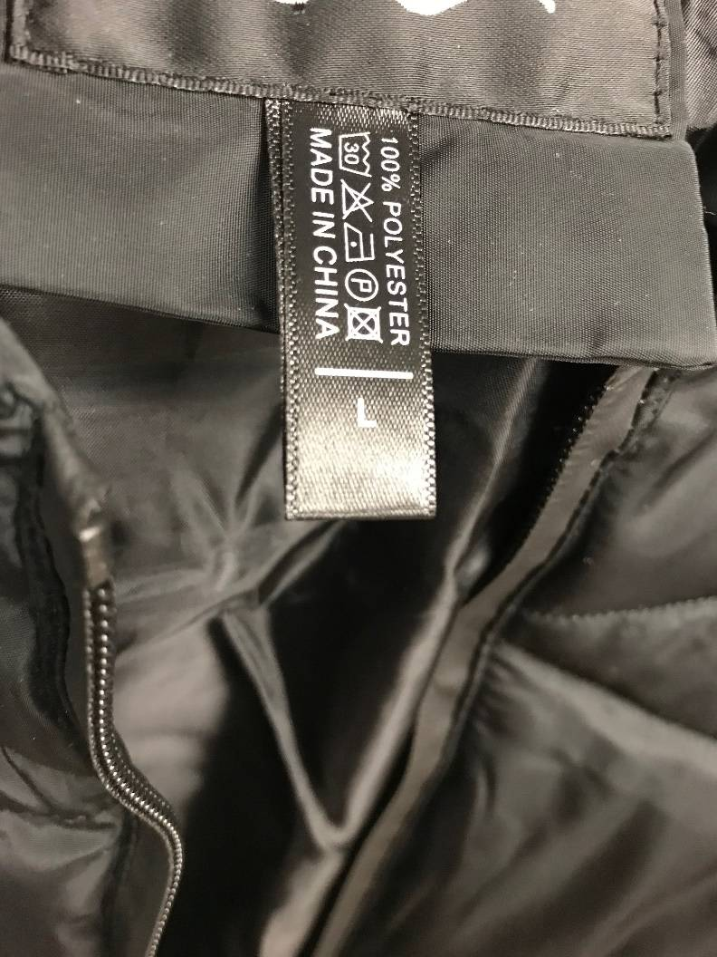
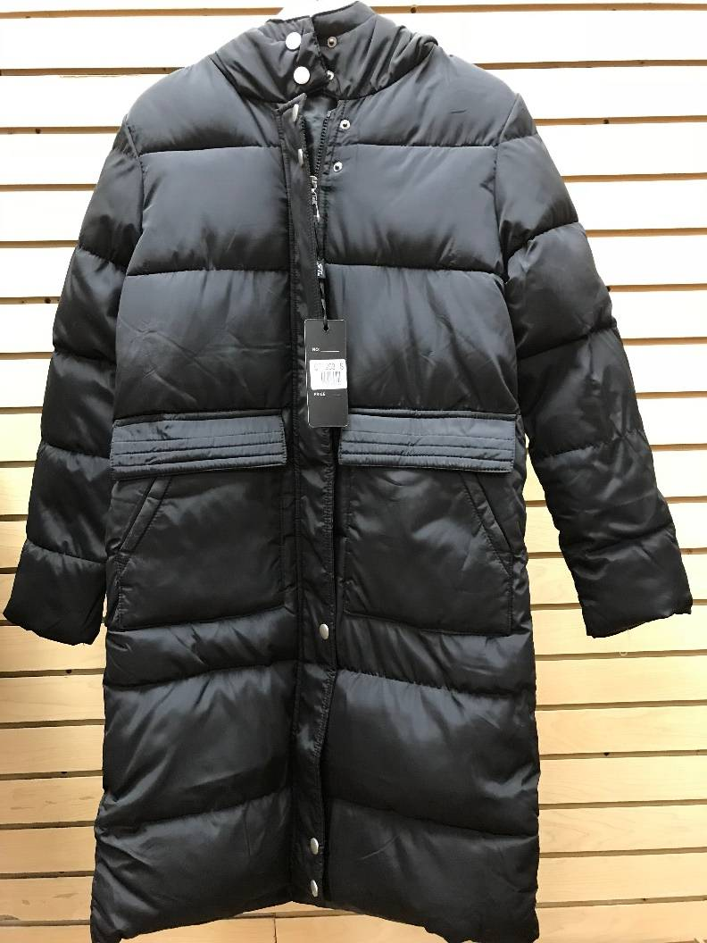
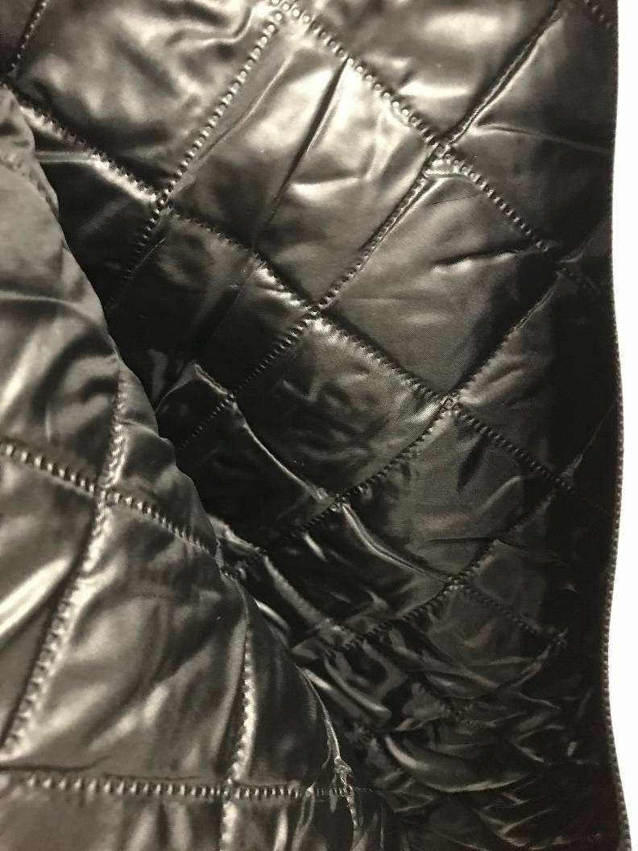
STYLE CT-1203 ~ Blk/504 PCs

Slide 3
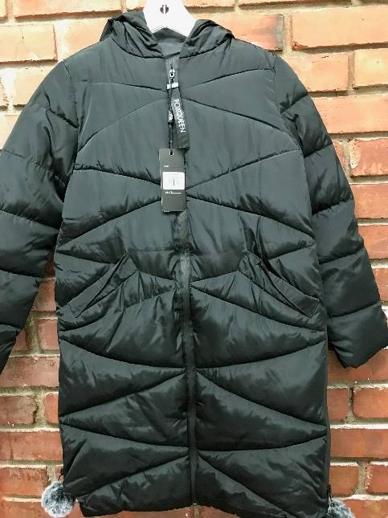
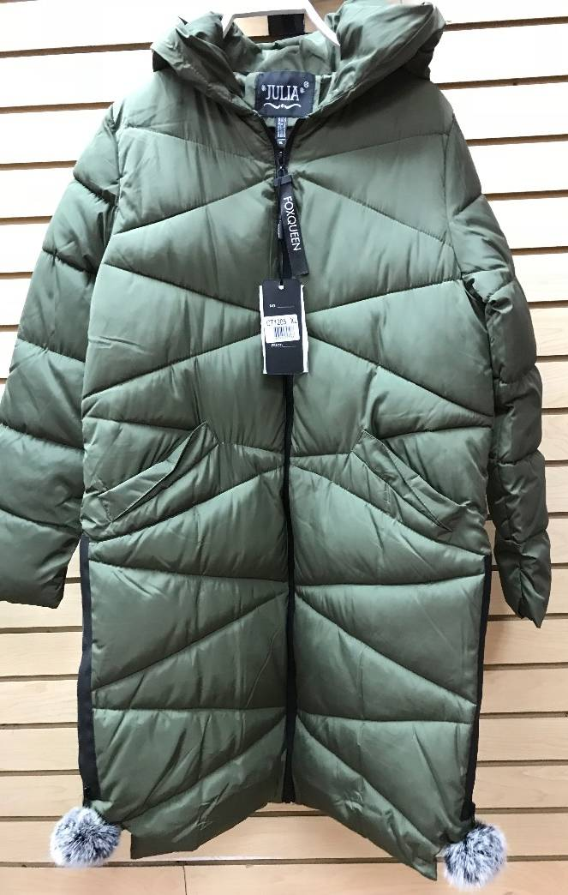
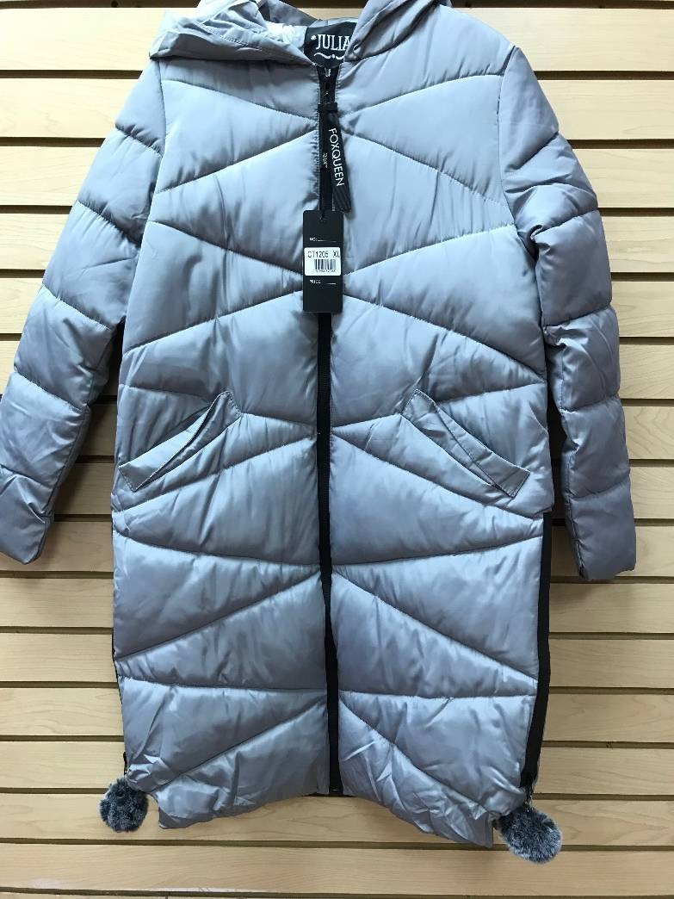
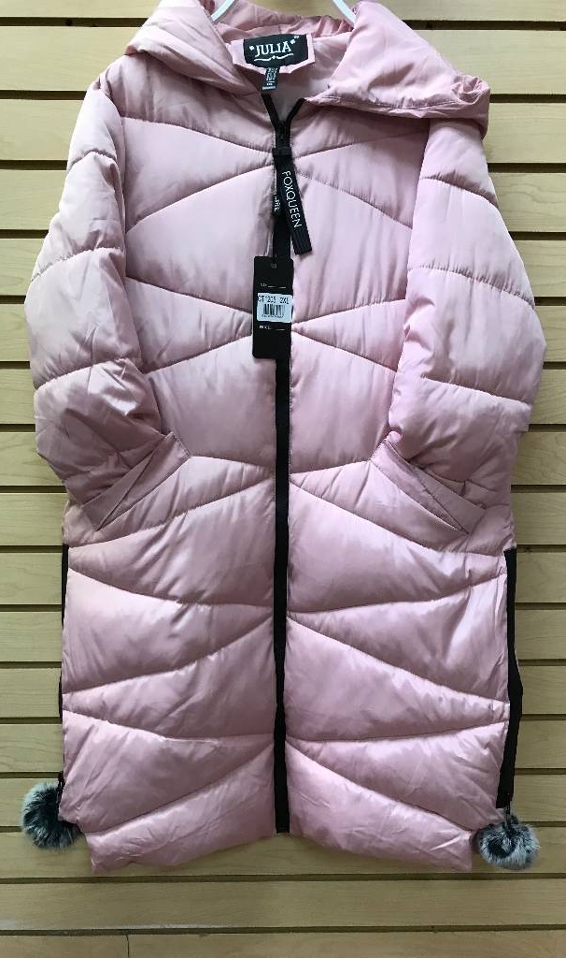
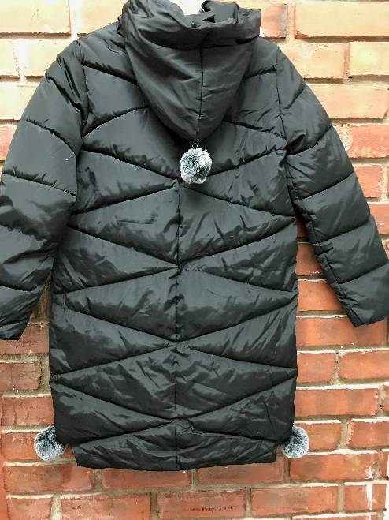
STYLE CT-1205 ~ Blk/960, AMY/340, L.Gry/320, PNK/300 = 1,920 Pcs

Slide 4
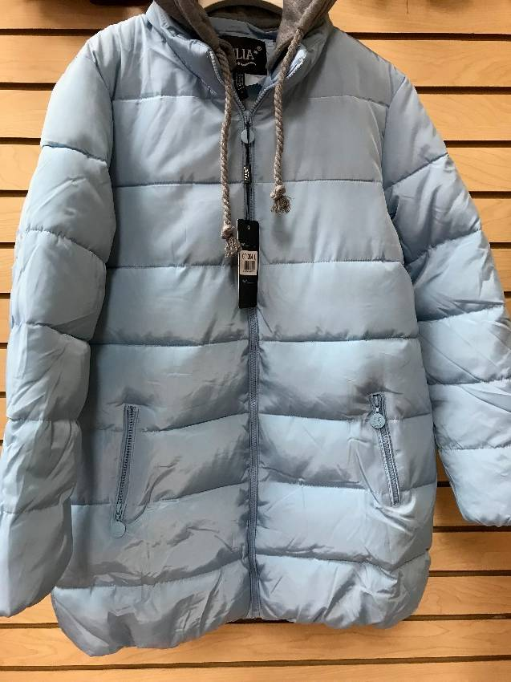
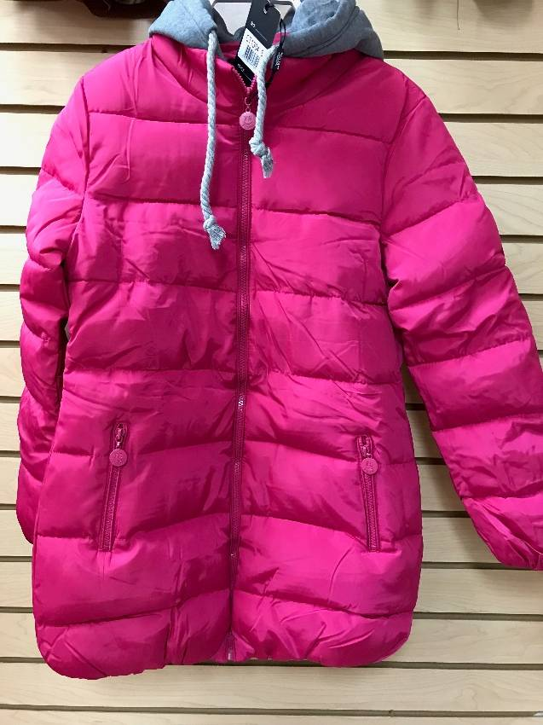
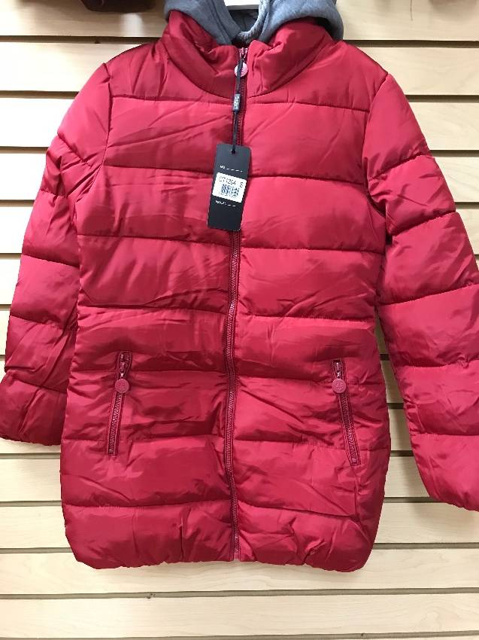
STYLE CT-1304 ~ Blk/528, L. Blue/156, Burgdy/ 444, Amy/144, pnk/348, L.Gry/276 = 1,896 PCs

Slide 5
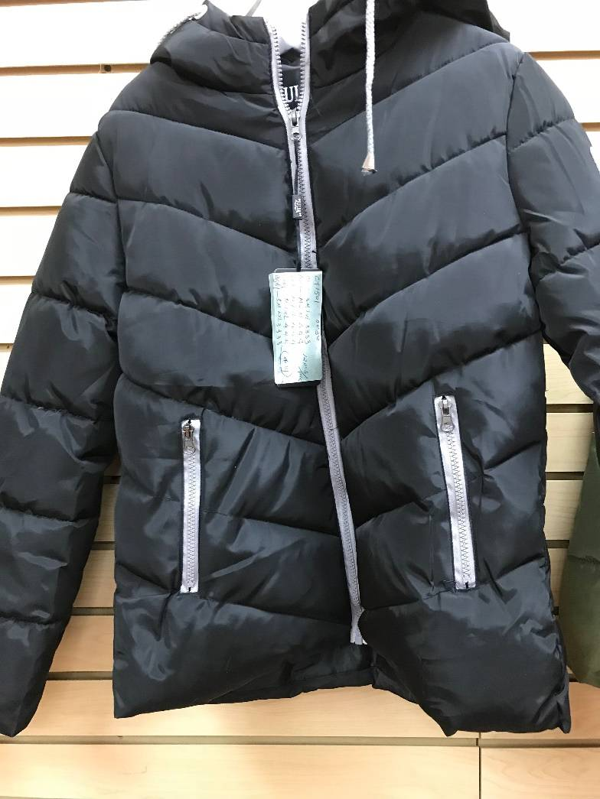
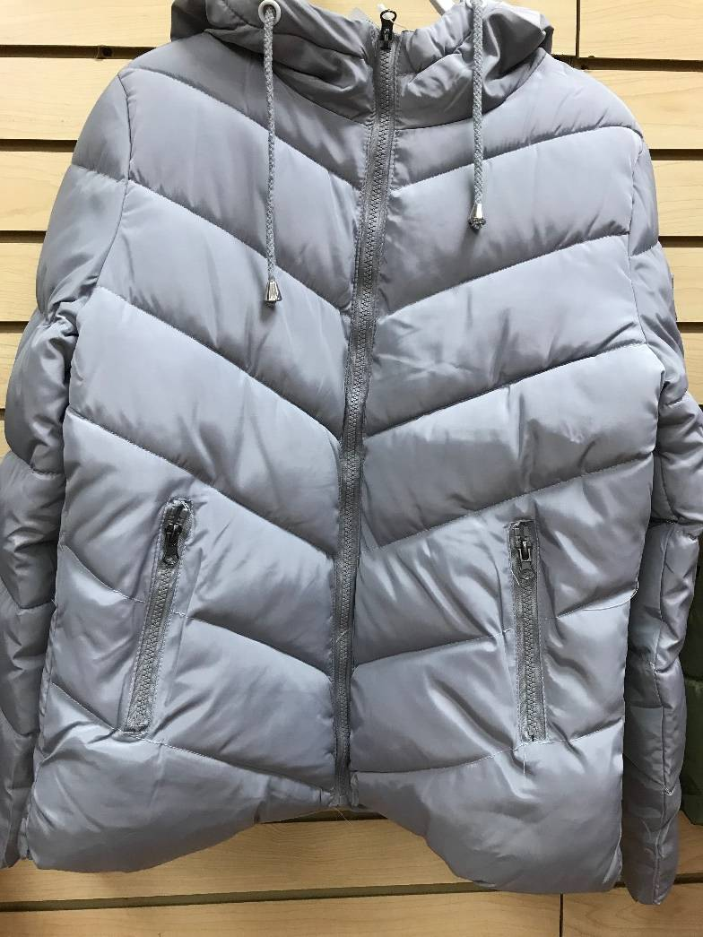
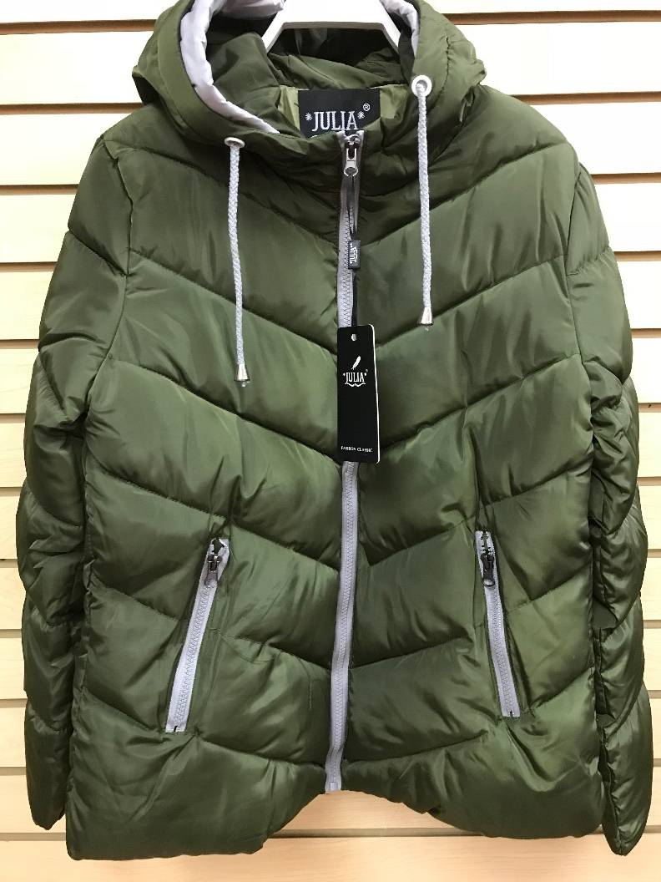
STYLE CT-1501 ~ Blk/1,020, Burgdy/168, L.gRY/288, Amy/216 = 1,692 PCs.

Slide 6
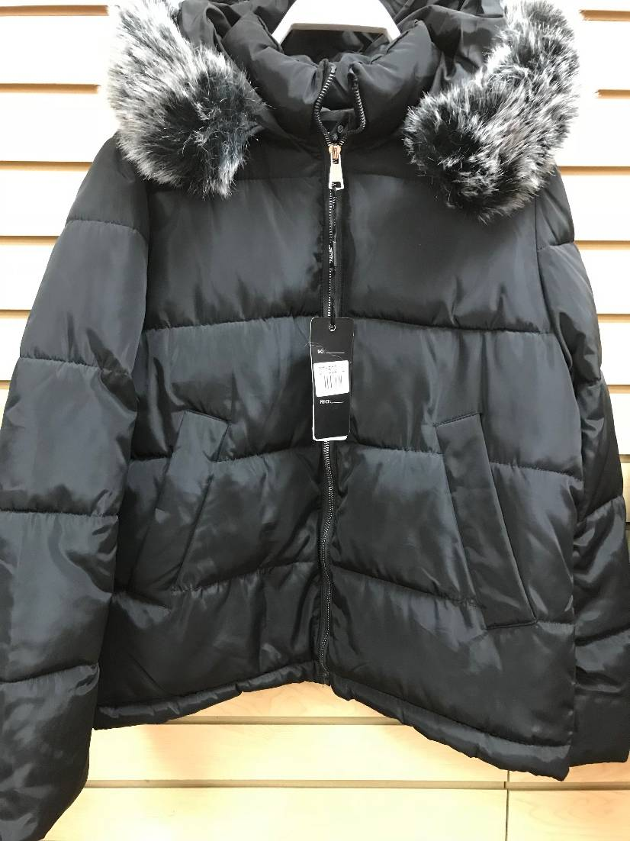
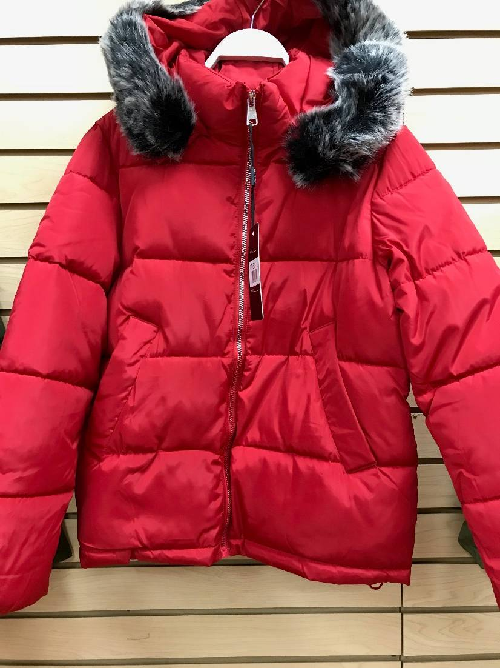
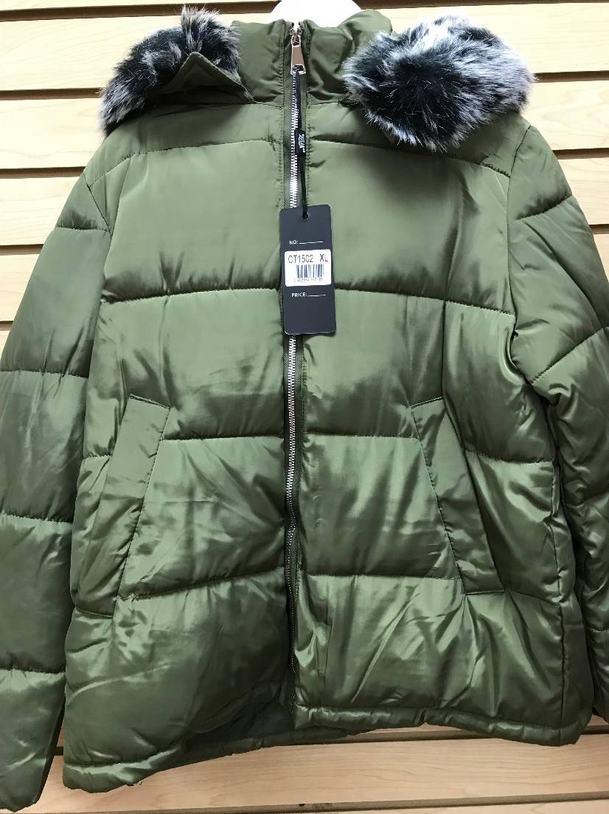
STYLE CT-1502 ~ Blk/1,824, Red/72, Pnk/96, Amy/96 = 2,088 PCs.

Slide 7
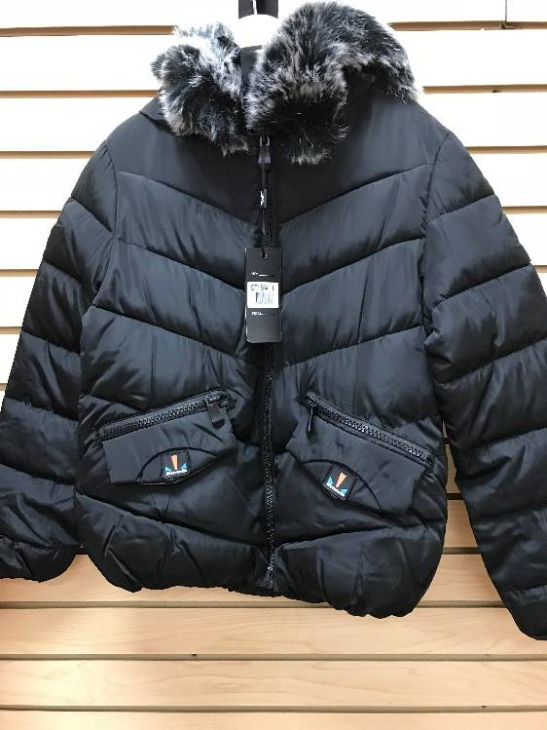
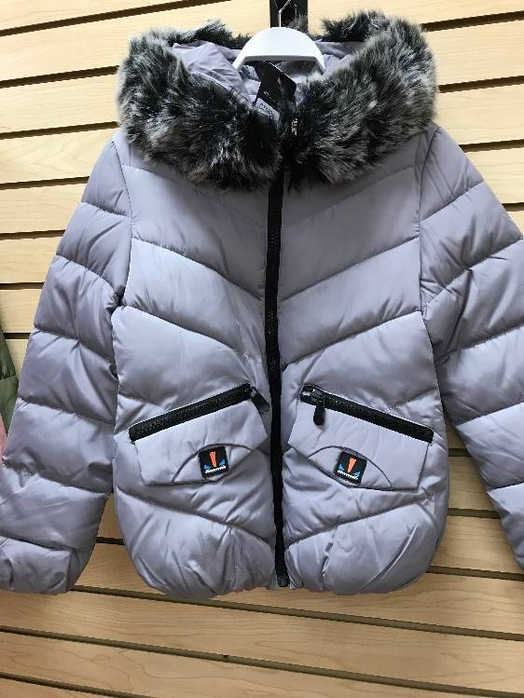
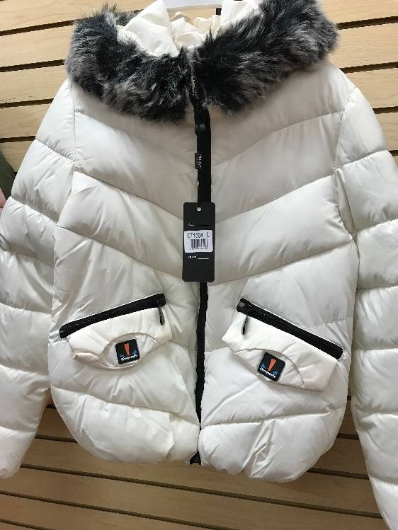
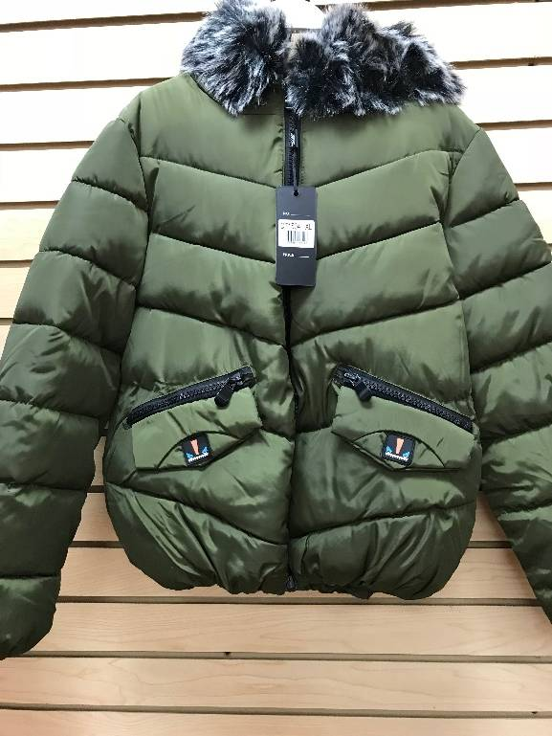
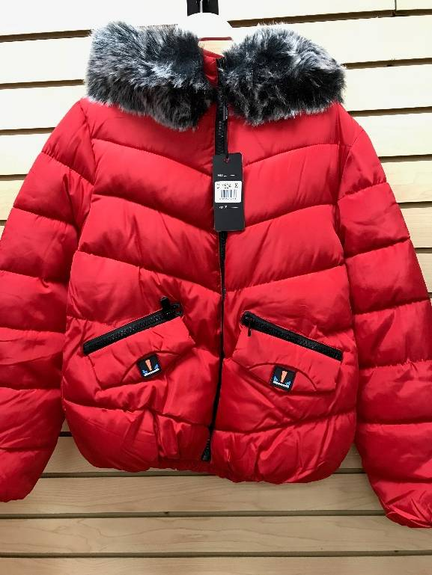
STYLE CT-1504 ~ Blk/912, Pnk/468, L.Gry/420, White/24, Amy/156, Red/12 = 1,992 PCs.

Slide 8
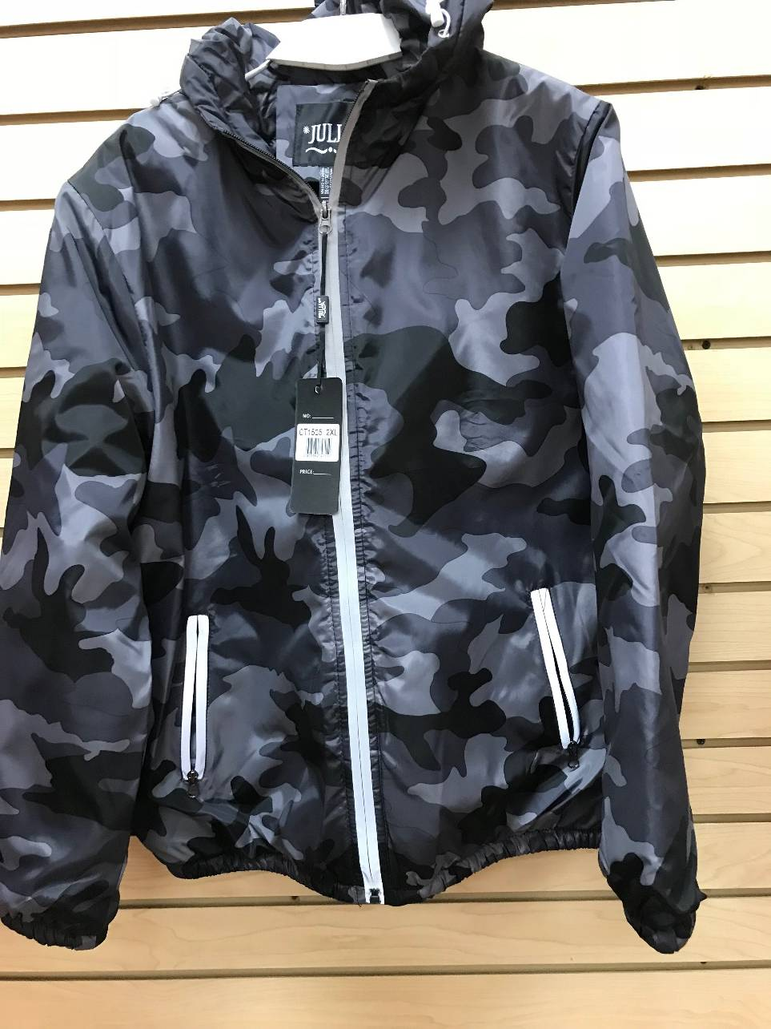
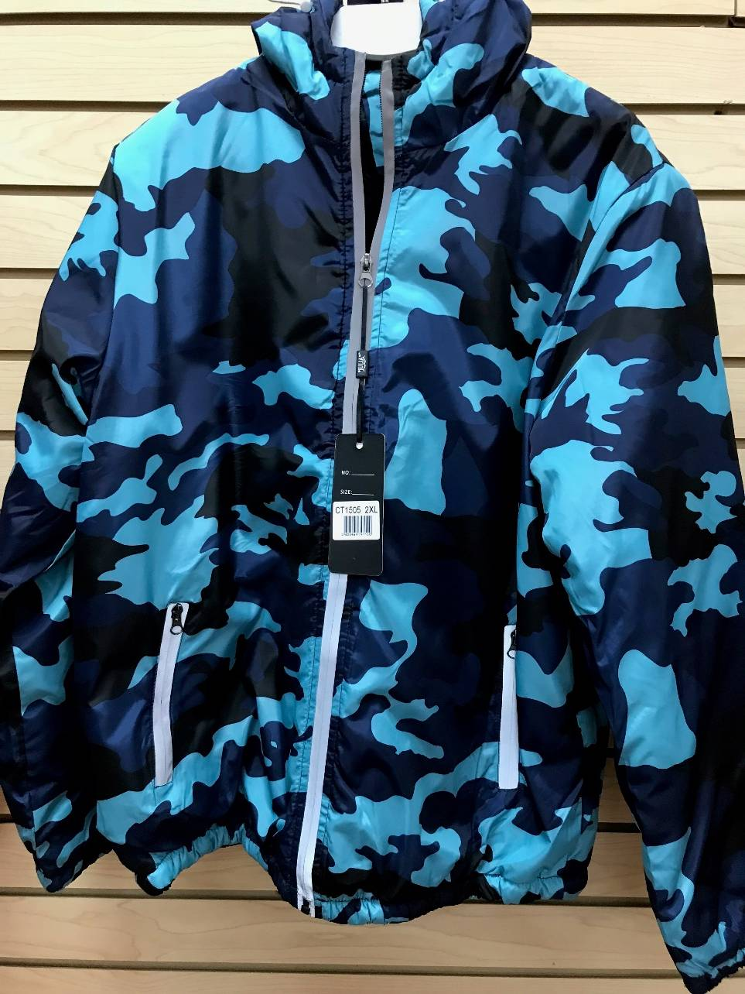
STYLE CT-1505 ~ Blk/Gey 2,000, Blue/Gry 1,900 = 3,900 PCs.

Slide 9
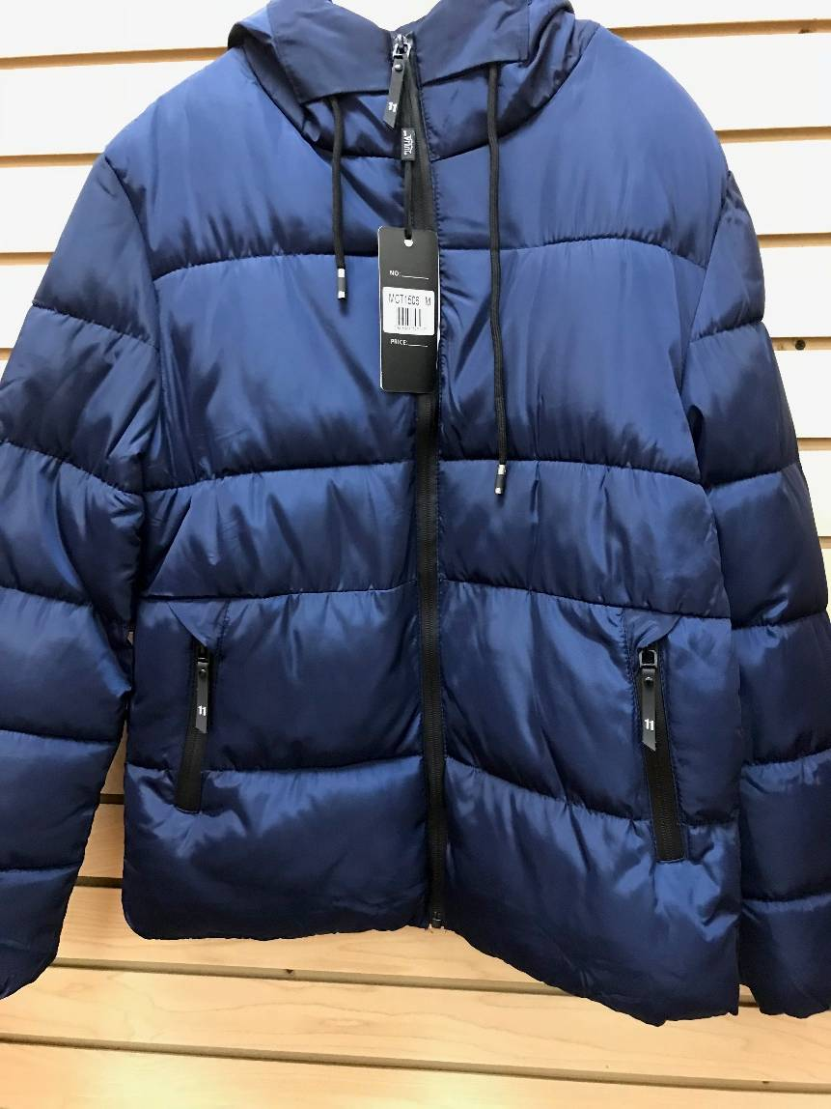
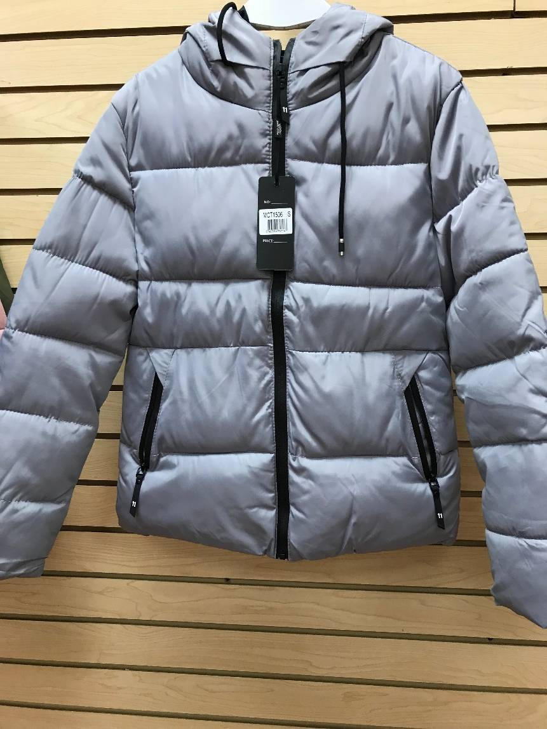
STYLE CT-1506 ~ Blk/276, Nvy/120, L.Gry/216 = 612 PCs.

Slide 10
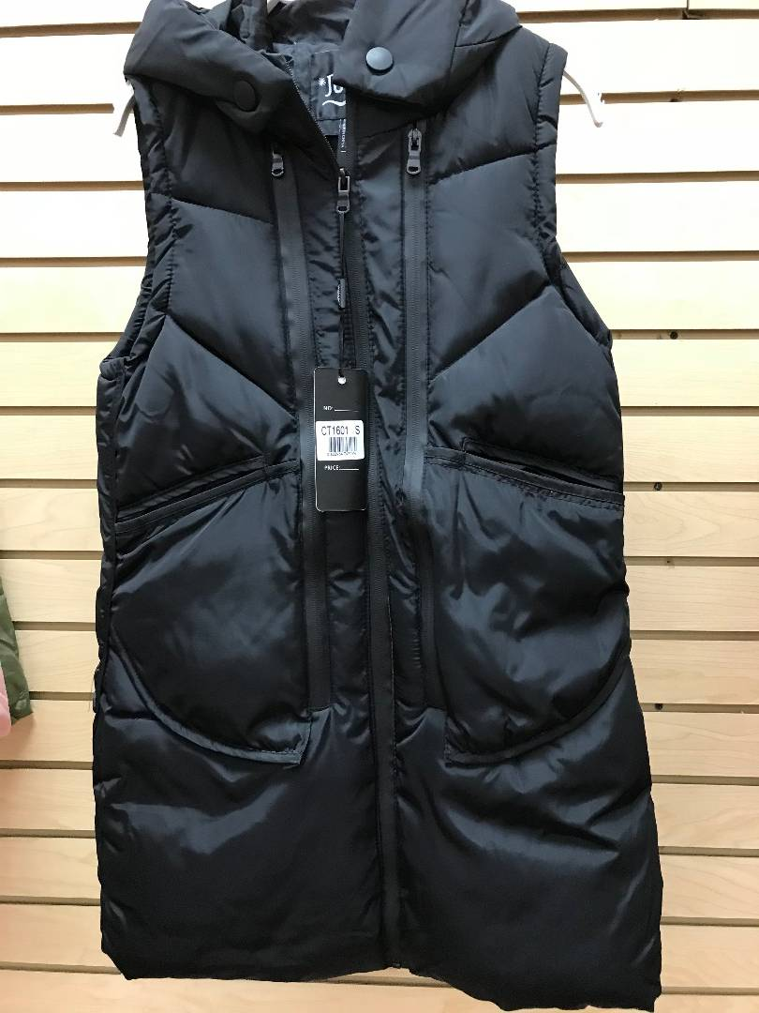
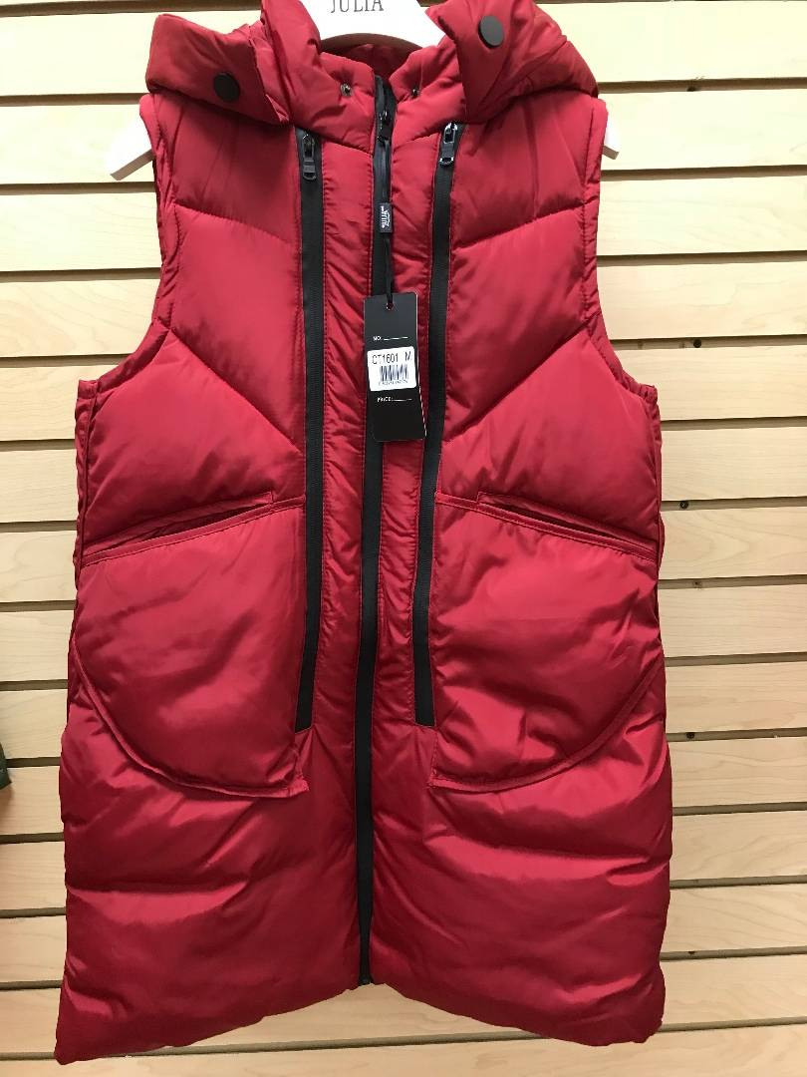
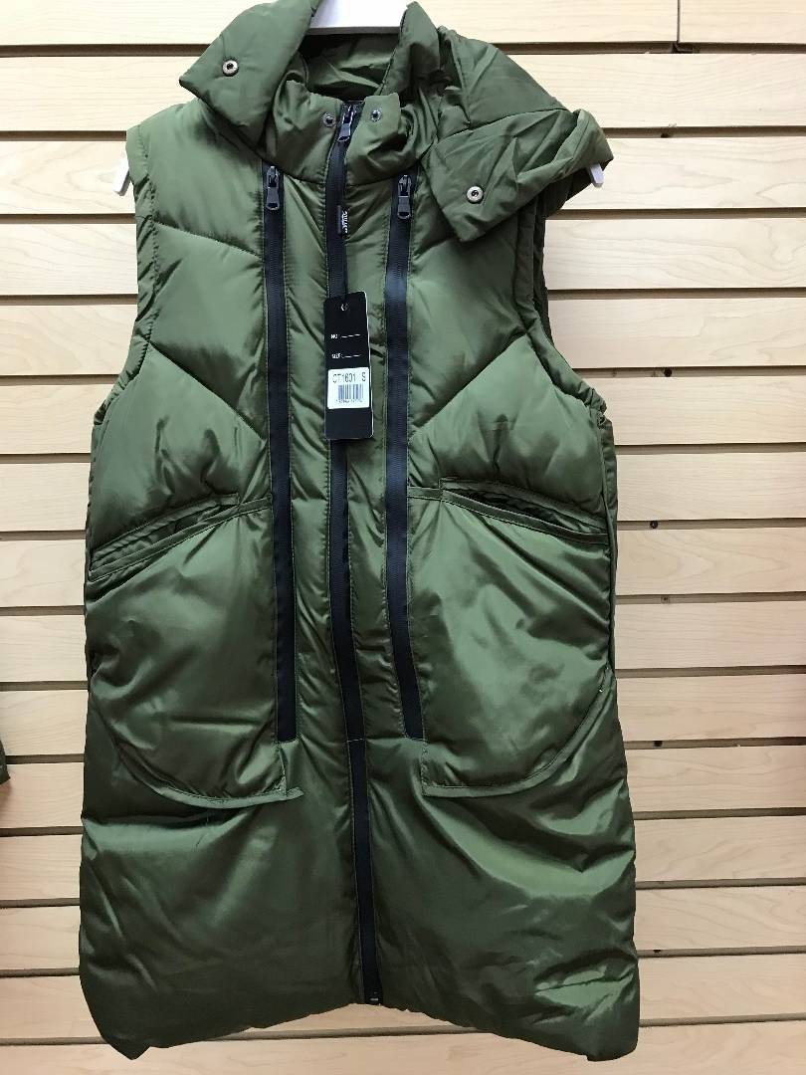
STYLE CT-1601 ~ Blk/720, Red/180, Amy/156 = 1,056 PCs.

Slide 11
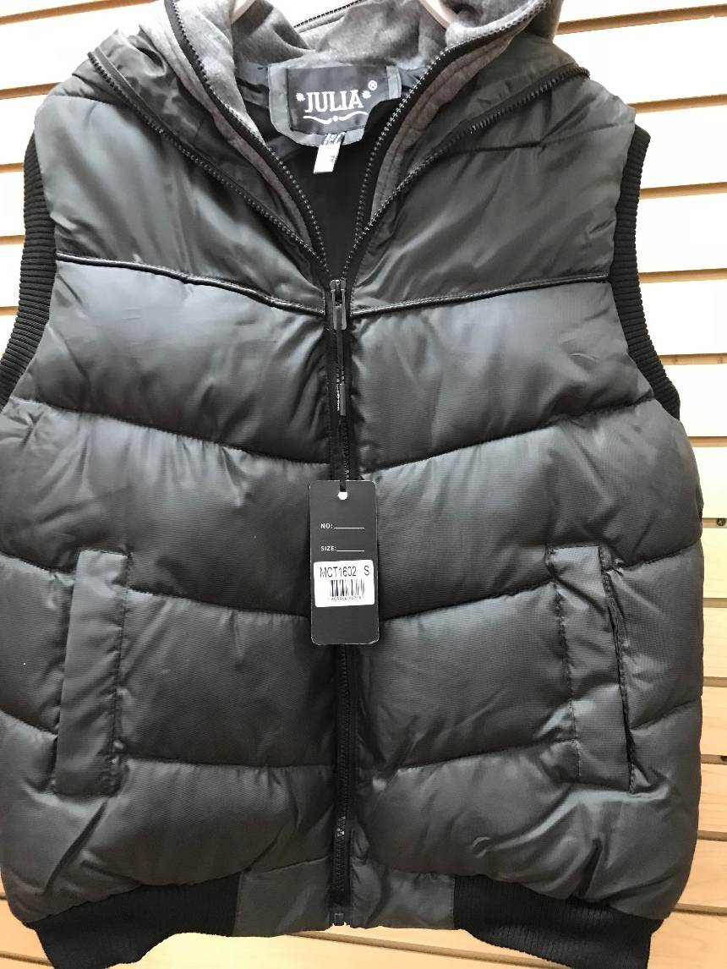
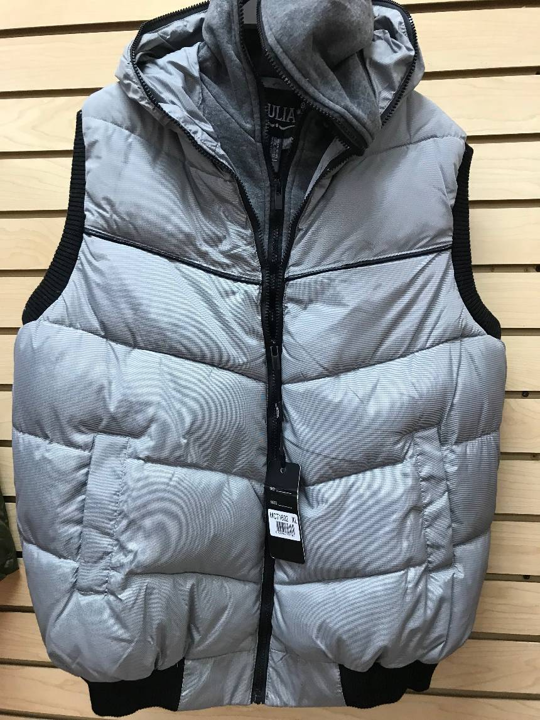
STYLE CT-1602 ~ D.Gry/ 252, L.Gry/204 = 456 PCs

